Slide 1

FIRST STEPS FOR POWER QUERY WITH MICROSOFT EXCEL
Notes:
https://swiy.co/musopen

Slide 2




HI, I’M GEORGE
Power Query PDQ!

Slide 3
OBJECTIVES
Vertically stack/append files
Compare the duct tape of lookup functions like VLOOKUP() and XLOOKUP() to the welder of relational joins
Compare left and inner joins (match or no match?)
Explore the world of exotic joins
All about joins in Power Query!

Slide 4

FOLLOWING ALONG
Download resources with link or QR code:
https://swiy.co/pq-joins
Power Query PDQ!
Notes:
https://swiy.co/pq-joins
This is an Excel class, so we won’t be looking at PowerPoint the whole time – to follow along, you will see that all assets are divided by section.
Some of our Excel time will be Demos – for this I will be walking through some procedure in Excel.
If you need any datasets they will be included in each sub-folder.
Then there may be a Drill where you will work on it for yourself during some specified period of time.
I have provided written notes/instructions about the Demos which you can refer to while working on the Drills.

Slide 5
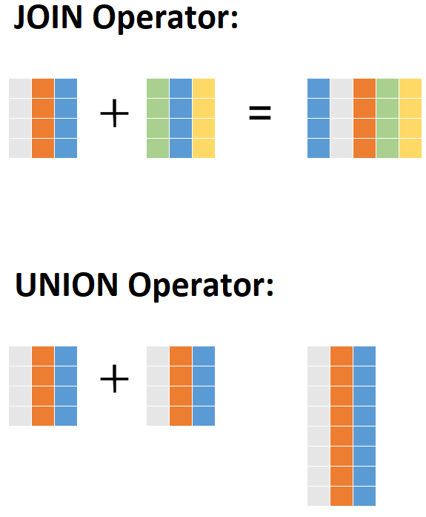

APPENDING DATA
Vertical “stack”
Pre-PQ: Copy-paste?
+ =
Notes:
Now we will switch it up a little bit

Slide 6
APPENDING: DEMO
Files: hof_yes.csv, hof_no.csv
Start with a blank Excel workboook
Notes:
Now we will switch it up a little bit

Slide 7
QUESTIONS?
I have one:
Who are these people?
Notes:
It looks like the first two names are Ty Cobb and Babe Ruth but how would I know that for sure? It’s not English? Why are we using these? If you have done a lookup before you may know why. We are going to get a lot more advanced with them

Slide 8
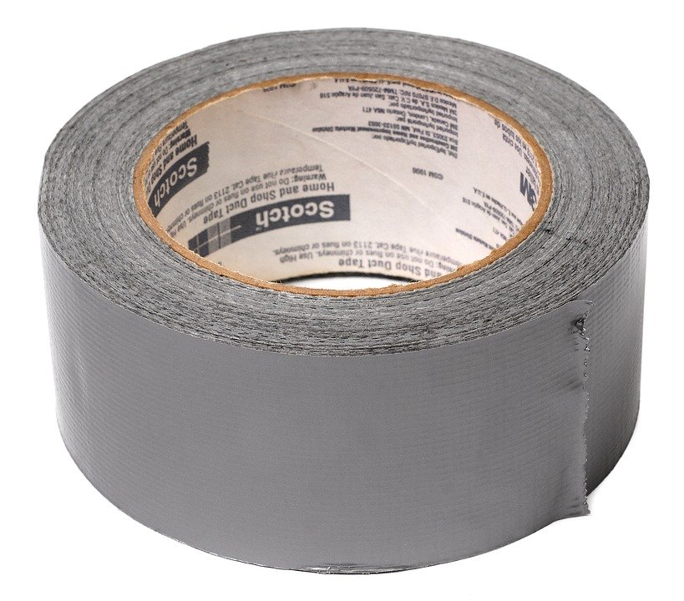

DUCT TAPE, MEET WELDER
VLOOKUP()
JOIN

Slide 9
DEMO
File: flights-and-planes.xlsx (the VLOOKUP way)
Notes:
Any questions on descriptive statistics?

Slide 10
Returns ALL records from Table A and matching records from Table B. Results with no match are null.
https://github.com/gadenbuie/tidyexplain#mutating-joins

Slide 11
Returns records that have matching values in Tables A and B
https://github.com/gadenbuie/tidyexplain#mutating-joins
Notes:
These are R functions but the idea is the same.

Slide 12
DEMO
File: flights-and-planes.xlsx (the Power Query way)
Notes:
Now, let’s see what happens with our data when we use a join versus a lookup.

Slide 13
QUESTIONS?
Notes:
Any questions on descriptive statistics?

Slide 14
THERE’S A WORLD OF JOINS
LEFT OUTER
RIGHT OUTER
A
B
A
B
FULL OUTER
A
B
INNER
A
A
LEFT ANTI
RIGHT ANTI
A
B
A
B

Slide 15
DEMO
File: championships-demo.xlsx
Which cities can claim only a baseball or football championship?
Left anti
Right anti
Baseball
Football
Baseball
Football
Notes:
Let’s imagine that our baseball team is the Left table and the Football teams is the Right table. If I only want the records of cities who have a baseball championship I can use a left anti. Vice versa for football cities.

Slide 16


Power Query corporate training
Learn more and connect at https://social.stringfestanalytics.com/pq-workshops
Human Centered Design • MDLS 2020
Notes:
If you are looking to individually take a Power Query class I have a surprise here at the end…

Slide 17

THANK YOU
LINKEDIN
linkedin.com/in/gjmount
EMAIL ADDRESS
george@stringfestanalytics.com
WEBSITE
stringfestanalytics.com
TWITTER
twitter.com/gjmount
Notes:
Thanks for coming! Feel free to contact me anytime, find me on LinkedIn, I also write frequently on this stuff so check out my website too.

Slide 18

TAKE THE SURVEY
How did I do today? Testimonials or other data welcome!
https://social.stringfestanalytics.com/event-feedback
Notes:
I’m a data analyst give me data on how I did
Testimonials also VERY helpful.

Slide 19
FINAL QUESTIONS?
Thanks for joining!
A recap email with recording, survey and more will be coming…
The recording stays up for seven days!
Notes:
Any questions on descriptive statistics?

Slide 20


BUT WAIT THERE’S MORE
50% OFF MY POWER QUERY COURSE THIS WEEK
PROMOCODE NOHARDCODES
https://swiy.co/learn-pq
Notes:
Any questions on descriptive statistics?

